Slide 1

COURSE: DATA SCIENCE tOPIC: Statistics INSTRUCTOR: REEMA MEMON

Slide 2
WHAT IS DATA?
Data is a collection of facts, such as numbers, words, measurements, observations, or just descriptions of things.
Data can be divided into two types:
STRUCTURED DATA
UNSTRUCTURED DATA

Slide 3
STRUCTURED DATA:
Data is organized and formatted in a specific way, following a predefined model.
Well-organized with a defined format, such as tables and columns.
Highly accessible and can be easily retrieved using a structured query language (SQL) or other database tools.
Examples: Customer information, transaction records, inventory lists, and financial data.

Slide 4
STRUCTURED DATA EXAMPLE:
ID | NAME | AGE | DEPARTMENT
02 | ALI | 23 | SOFTWARE
04 | HASAN | 22 | BIO-MEDICAL
10 | AHSAN | 21 | TELECOM

Slide 5
UNSTRUCTURED DATA:
Data that lacks a specific structure or format and is typically unorganized or in raw form.
Lacks a predefined format and is unorganized.
Less accessible and requires advanced techniques for extraction and analysis.
Examples are text, images, audio, video, social media posts, emails, web pages, and other free-form content.

Slide 6
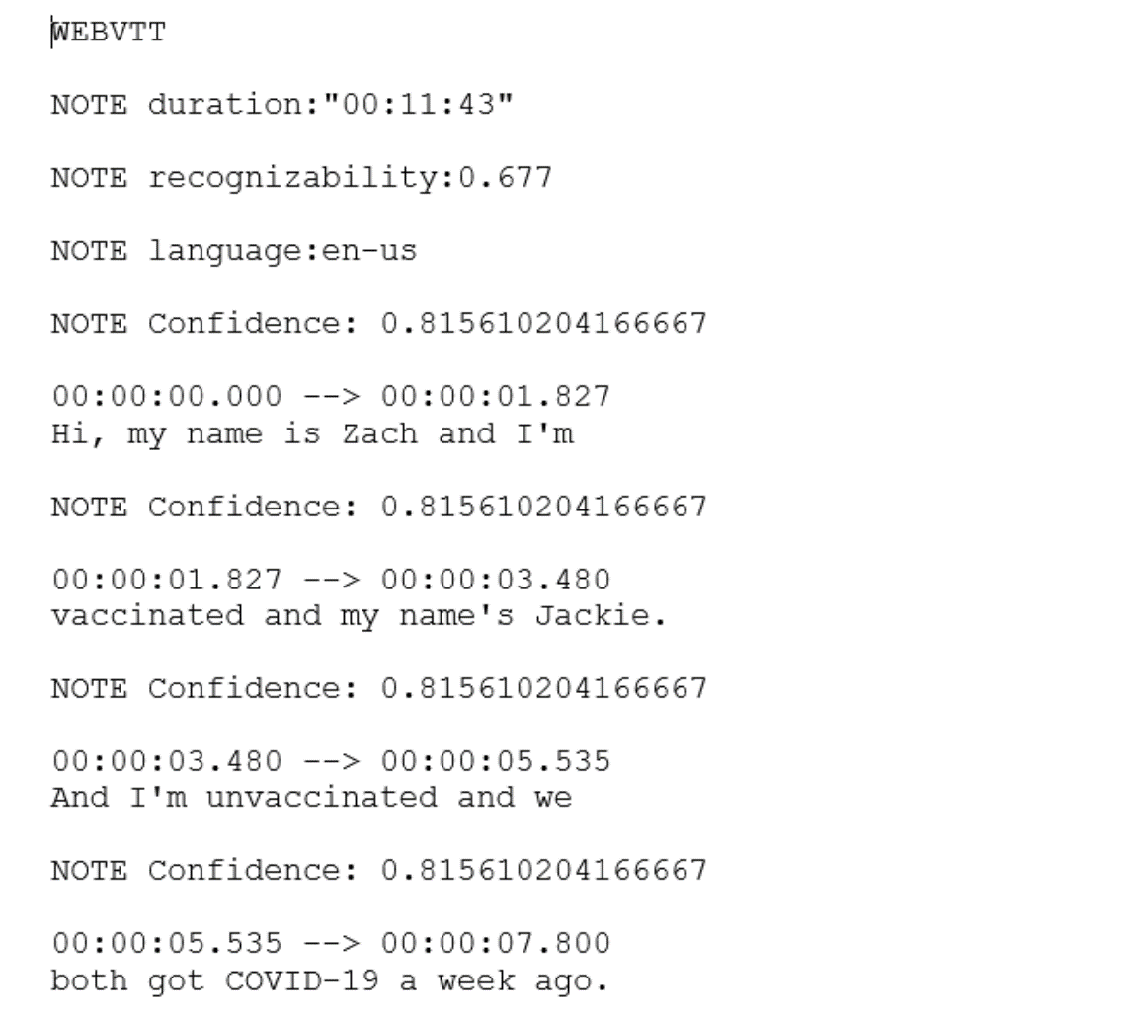
UNSTRUCTURED DATA EXAMPLE:
The below mentioned example is of a text file generated from MS Streams through speech-to-text of a video.

Slide 7
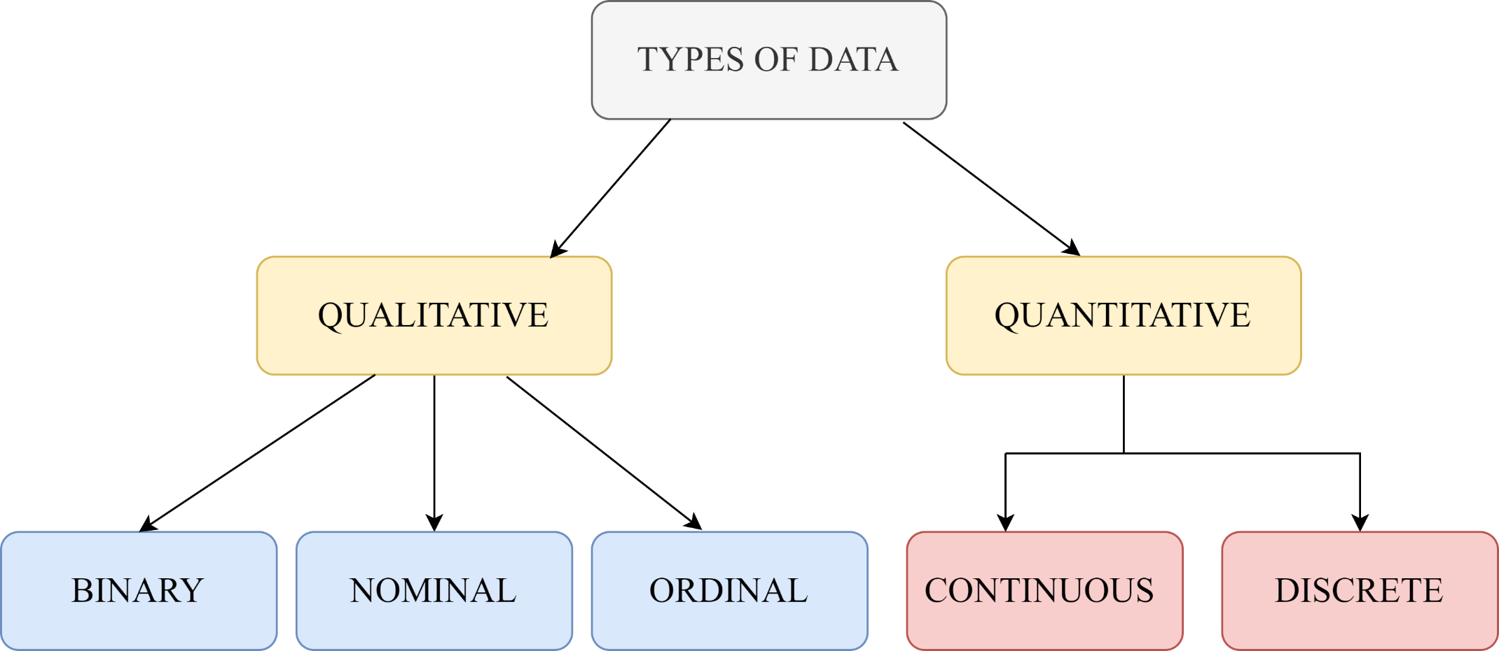
Data can be further divided into QUALITATIVE and QUANTITATIVE.

Slide 8
QUALITATIVE DATA:
It is descriptive information (it describes something).
Qualitative data tells about the perception of people. This data helps market researchers understand the customers’ tastes and then design their ideas and strategies accordingly.
Examples of qualitative data are :
What language do you speak
Favorite holiday destination
Opinion on something (agree, disagree, or neutral)
Colors

Slide 9
QUALITATIVE data can be further classified into:
BINARY
NOMINAL
ORDINAL
BINARY DATA: A binary variable has two categories or levels. It represents a yes/no or true/false type of data. Examples of binary variables include gender (male/female), presence/absence, success/failure, or 0/1 indicators. Binary variables can be represented using numeric values (0 and 1) or text labels ("Yes" and "No").

Slide 10
NOMINAL DATA:
The name “nominal” comes from the Latin name “nomen,” which means “name.” With the help of nominal data, we can’t do any numerical tasks or can’t give any order to sort the data. These data don’t have any meaningful order. Their values are distributed into distinct categories.
Nominal Data is used to label variables without any order or quantitative value.
Examples of Nominal Data
Color of hair (Blonde, red, Brown, Black, etc.)
Nationality (Indian, German, American)
Gender (Male, Female, Others)
Eye Color (Black, Brown, etc.)

Slide 11
ORDINAL DATA:
Ordinal data have natural ordering where a number is present in some kind of order by their position on the scale. These data are used for observation like customer satisfaction, happiness, etc., but we can’t do any arithmetical tasks on them.
Compared to nominal data, ordinal data have some kind of order that is not present in nominal data.
Examples:
When companies ask for feedback, experience, or satisfaction on a scale of 1 to 10
Letter grades in the exam (A, B, C, D, etc.)
Ranking of people in a competition (First, Second, Third, etc.)
Economic Status (High, Medium, and Low)
Education Level (Higher, Secondary, Primary)

Slide 12
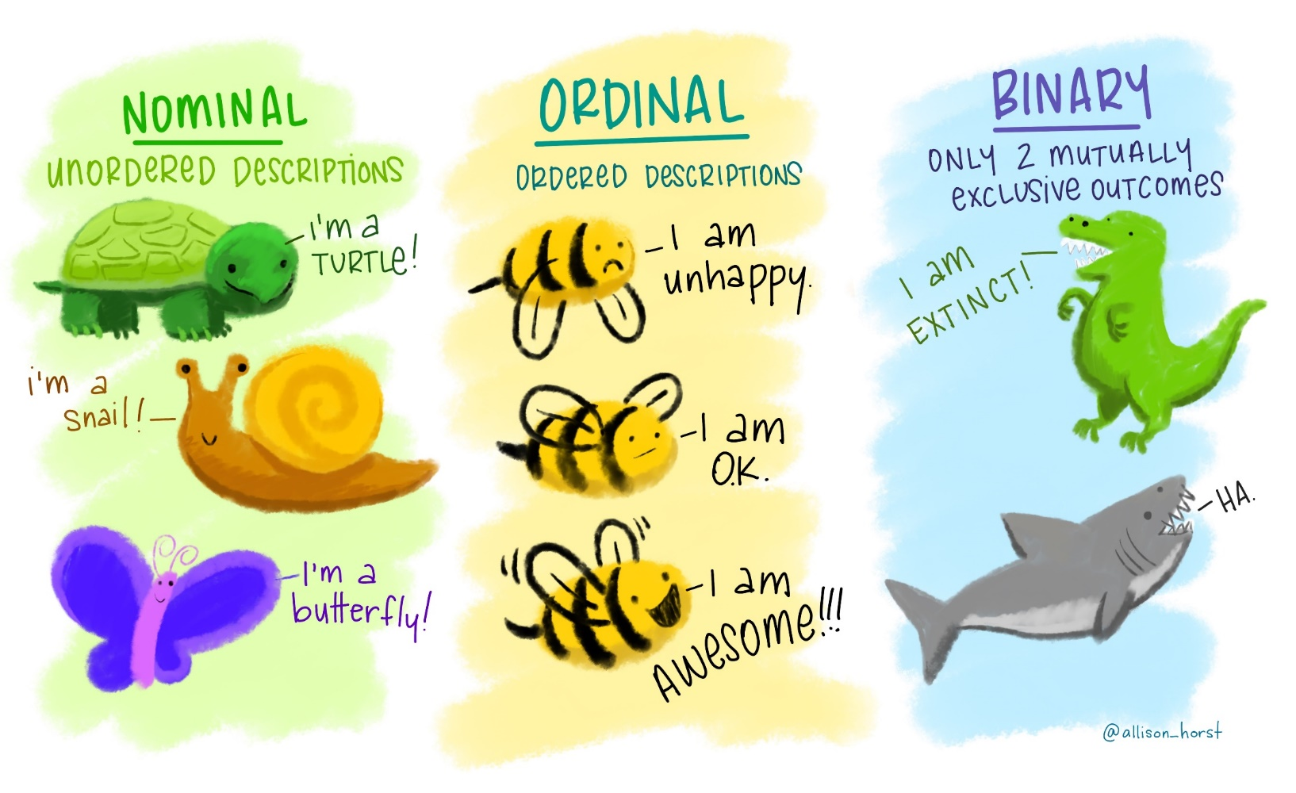

Slide 13
QUANTITATIVE DATA:
Quantitative data can be expressed in numerical values, making it countable and including statistical data analysis. These kinds of data are also known as Numerical data.
These data can be represented on a wide variety of graphs and charts, such as bar graphs, histograms, scatter plots, boxplots, pie charts, line graphs, etc.
Examples:
Height or weight of a person or object
Room Temperature
Scores and Marks (Ex: 59, 80, 60, etc.)
Time

Slide 14
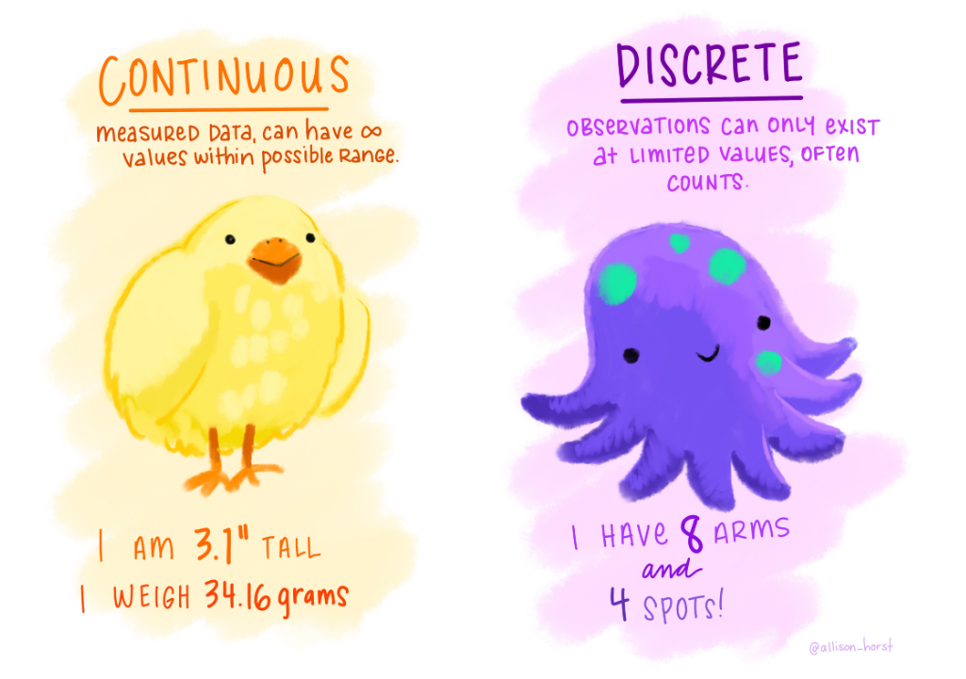
QUANTITATIVE data is divided into two types:
DISCRETE
CONTINUOUS

Slide 15
DISCRETE VARIABLE:
The term discrete means distinct or separate.
The discrete data contain the values that fall under integers or whole numbers.
The total number of students in a class is an example of discrete data.
These data can’t be broken into decimal or fraction values.
Examples:
Total numbers of students present in a class
Cost of a cell phone
Numbers of employees in a company
The total number of players who participated in a competition
Days in a week

Slide 16
CONTINUOUS VARIABLE:
A continuous variable is a variable that can take on any value within a range.
A continuous variable takes on an infinite number of possible values within a given range.
Because the possible values for a continuous variable are infinite, we measure continuous variables (rather than count), often using a measuring device like a ruler or stopwatch.
Continuous variables include all the fractional or decimal values within a range.
Examples:
Height of a person
Speed of a vehicle
“Time-taken” to finish the work
Wi-Fi Frequency
Market share price

Slide 17
IS AGE CONTINUOUS OR DISCRETE?
ANY GUESSES?

Slide 18
Age can be treated as either discrete or continuous depending on the context and the level of measurement used. For example, age can be treated as discrete when using specific age categories (e.g., 0-5, 6-10, 11-15), or as continuous when considering exact ages (e.g., 3.5 years, 12.2 years).

Slide 19
WHAT IS STATISTICS?
Statistics is the science of data.
Statistics deals with data collection, classification, analysis, and interpretation.
Two major areas of statistics are:
Descriptive Statistics
Inferential Statistics

Slide 20
LET US LEARN ABOUT DESCRIPTIVE STATISTICS
DESCRIPTIVE STATISTICS:
Descriptive statistics refers to a branch of statistics that focuses on summarizing and describing the main features of a dataset.
Descriptive statistics are broken down into:
MEASURES OF CENTRAL TENDENCY (MEAN, MODE, MEDIAN)
MEASURES OF DISPERSION (VARIANCE, STANDARD DEVIATION, ETC)

Slide 21
MEAN, MEDIAN, AND MODE
Mean, median, and mode are the measures of central tendency, used to study the various characteristics of a given set of data.
A measure of central tendency describes a set of data by identifying the central position in the data set as a single value.

Slide 22
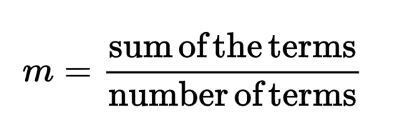
MEAN:
The arithmetic mean of a given data is the sum of all observations divided by the number of observations.
A student obtains 78,67,88,94,75 marks in 5 subjects of his university semester. Calculate the mean number of marks.

Slide 23
QUESTIONS:
Given the dataset {12, 15, 18, 21, 25}, calculate the mean.
The mean height of a basketball team is 180 cm. If the total height of all the players combined is 1800 cm, how many players are on the team?
A set of numbers has a mean of 15. If four out of the five data points are given as 12, 14, 16, and 18, what is the fifth data point?
The mean of a dataset is 30. If the dataset contains 8 numbers with values of 25, 30, 35, 28, 32, 31, 27, and x, what is the value of x.
The average of runs of a cricket player of 10 innings was 32. How many runs must he make in his next innings so as to increase his average of runs by 4 ?

Slide 24
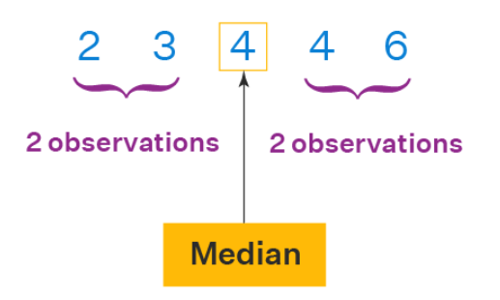
MEDIAN:
The value of the middlemost observation, obtained after arranging the data in ascending or descending order, is called the median of the data.
Step 1: Arrange the data in ascending or descending order.
Step 2: Let the total number of observations be n.

Slide 25
To find the median, we need to consider if n is even or odd.
If n is odd, then use the formula:
Median = [(n + 1)/2]th observation
If n is even, then use the formula:
Median = [(n/2)th obs.+ ((n/2) + 1)th obs.]/2

Slide 26
Example 1: Let's consider the data: 56, 67, 54, 34, 78, 43, 23. What is the median?
Solution:
Arranging in ascending order, we get: 23, 34, 43, 54, 56, 67, 78. Here, n (number of observations) = 7
So, (7 + 1)/2 = 4
∴ Median = 4th observation
Median = 54

Slide 27
Example 2: Let's consider the data: 50, 67, 24, 34, 78, 43. What is the median?
Solution:
Arranging in ascending order, we get: 24, 34, 43, 50, 67, 78.
Here, n (no.of observations) = 6
6/2 = 3
Using the median formula,
Median = (3rd observation + 4th observation) / 2
= (43 + 50)/2
Median = 46.5

Slide 28
QUESTIONS:
The export of agricultural product in million dollars from a country during eight quarters in 1974 and 1975 was recorded as 29.7, 16.6, 2.3, 14.1, 36.6, 18.7, 3.5, 21.3.
The number of rooms in the five five stars hotel in Karachi city is 71, 30, 61, 59, 31, 40 and 29. Find the median number of rooms

Slide 29
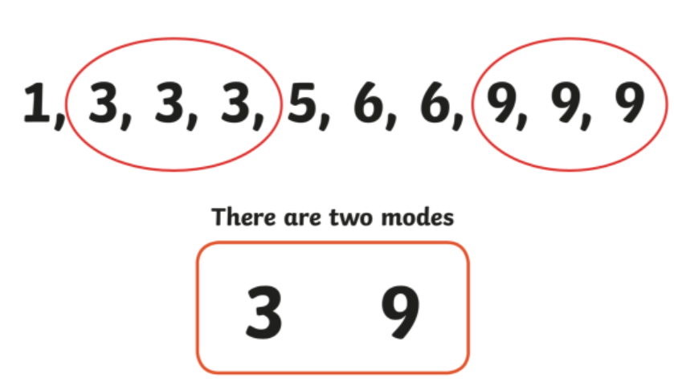
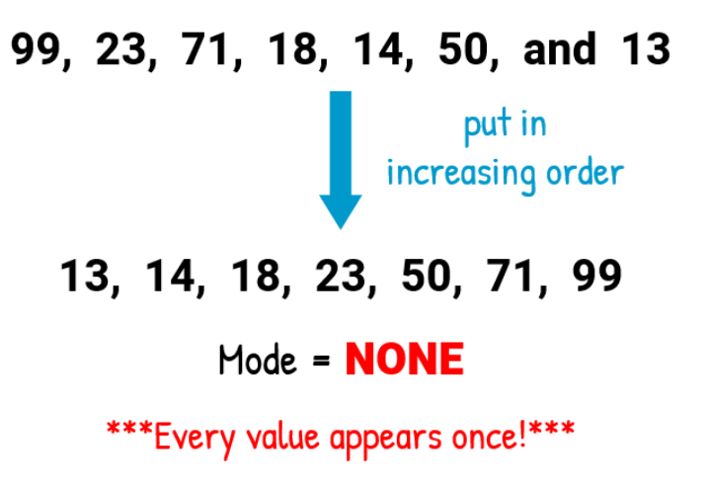
MODE:
It represents the most frequently occurring value or values in a dataset. In simpler terms, the mode is the value that appears most often in a given set of data.
It is important to note that a dataset may have no mode if all values occur with the same frequency, or it may have multiple modes if there are multiple values tied for the highest frequency.

Slide 30
QUESTIONS:
A teacher recorded the heights (in centimeters) of 20 students in a class. The recorded heights were as follows: 150, 155, 160, 165, 155, 160, 155, 150, 165, 155, 160, 155, 165, 150, 155, 160, 165, 155, 160, 155. What is the mode for the heights?

